Slide 1
Access Controls and Managing Services
4.3 Managing Permissions and Services

Slide 2
Class Objectives
By the end of class, you will be able to:
Inspect and set file permissions for sensitive files on the system.
Manage and monitor services on the system, and remove unused services.
Create and assign users for services.

Slide 3
Access Controls

Slide 4

Like Google Docs, Linux has access controls, which grant permission to access documents and files on a host.
4
Notes:
Image source: shutterstock_1083618569

Slide 5
Managing Access Controls in Linux
Linux categorizes files, programs, and directories as items.
Item

Slide 6
Managing Access Controls in Linux
Each item has privileges set for the owner of the item, the group associated with the item, and others.
Item
Owner
Group
Other

Slide 7
Managing Access Controls in Linux
Each item has privileges set for the owner of the item, the group associated with the item, and others.
Item
Owner
Group
Other
Typically the user who created the item.
(But this can be changed).
Typically the primary group associated with the owner.
(This can also be changed.)
Everyone who is not the owner, and not in the group.

Slide 8
Managing Access Controls in Linux
For each of these categories, there are three actions that we can allow or prevent:
read, write, execute.
Item
Owner
Group
Other
Can the owner read this item?
Can the group read this item?
Can others read this item?
Can the owner write this item?
Can the group write this item?
Can others write this item?
Can the owner execute this item?
Can the group execute this item?
Can others execute this item?

Slide 9
Managing Access Controls in Linux
Assigning these permissions is called Discretionary Access Control (DAC).
It is discretionary because permissions can pass from one item to another.
Item
Owner
Group
Other
Can the owner read this item?
Can the group read this item?
Can others read this item?
Can the owner write this item?
Can the group write this item?
Can others write this item?
Can the owner execute this item?
Can the group execute this item?
Can others execute this item?

Slide 10
Permissions Demo
In the upcoming demo, we’ll create a file and a directory, observing default permissions. Then, we will change the permissions to deny certain groups and users access.
To read and manipulate these file permissions, we’ll use these commands:
ls -l | Show the permissions info.
chmod | Change the permissions info.
chown | Change the owner and group of a file.

Slide 11
Permissions

Slide 12
Inspecting File Permissions
-rw-r--r--
Item type (- for file, d for directory)

Slide 13
Inspecting File Permissions
-rw-r--r--
Owner permission (in this case, read and write)
Item type

Slide 14
Inspecting File Permissions
-rw-r--r--
Group permission (read)
Owner permission (in this case, read and write)
Item type

Slide 15
Inspecting File Permissions
-rw-r--r--
Other / world permission (read)
Group permission (read)
Owner permission (in this case, read and write)
Item type

Slide 16
Changing File Permissions
File permissions can be set using two different notations: symbolic and octal.
Symbolic Notation
r | read
w | write
x | execute
rwx rw- r--
User can read, write execute
Group can read and write
Others can read

Slide 17
Changing File Permissions
File permissions can be set using two different notations: symbolic and octal.
Octal Notation
 | 4 | 2 | 1
0 | - | - | - | No permission
1 | - | - | x | Only execute
2 | - | w | - | Only write
3 | - | w | x | Write and execute
4 | r | - | - | Only read
5 | r | - | x | Read and execute
6 | r | w | - | Read and write
7 | r | w | x | Read, write, and execute
rwx rw- r--
4 + 2 + 1
4 + 2 + 0
4 + 0 + 0
7
6
4
764
User can read, write execute
Group can read and write
Others can read

Slide 18
Activity: Access Controls and Permissions
In this activity, you will inspect and set file permissions on a few of the most sensitive items on a Linux system.
25 Minutes

Slide 20
Recap: Permissions
How permissions apply to each specific file and folder with r, w, and x.
Symbolic Notation
r | read
w | write
x | execute
rwx rw- r--
User can read, write execute
Group can read and write
Others can read

Slide 21
Permissions
How to view and apply permissions to an item’s user, group, and other.
Users
Groups
Root
Every file and program on a Linux system has permissions.
These permissions tell the system which users can access the file or run the program.
Users can be placed in groups, which can have special permissions that apply to all members of the group.
File and program permissions apply to all users in a system, except the root user.
The root user (or super user) has complete access and can perform any action.

Slide 22
Permissions
We can use sudo user to invoke the root user and bypass any permissions.
ls -l | To show the permissions info.
chmod | To change the permissions info.
chown | To change the owner and group of a file.

Slide 23
Permissions
We can assign sudo for a specific command for a specific user.
whoami | To determine the current user.
su | To switch to another user, in this case the root user.
sudo | To invoke the root user for one command only.
sudo -l | To list the sudo privileges for a user.
visudo | To edit the sudoers file.

Slide 25
Managing Services

Slide 26

Servers are computers that offer services to other computers.

Slide 27

Managing Services
A service is a function or capability that a machine makes available to another.
For example, file sharing services allow computers to send and receive data.
Notes:
shutterstock_160754045

Slide 28

Managing Services
Some services, like Tripwire, are only run locally on the server and are not provided to other computers. These services are packages that can be installed and removed just like other programs.
tripwire.com

Slide 29
Services and Security

Slide 30

Services and Security
Attackers can manipulate services into doing things that they are not designed to do.
Notes:
shutterstock_1085385533

Slide 31
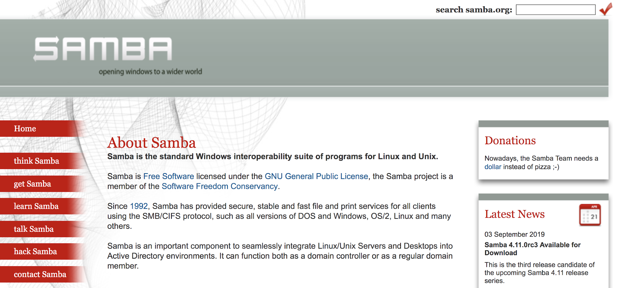
Services and Security
For example: Samba (SMB), the file sharing protocol, allows users to view, download, and store files remotely.
samba.org

Slide 32

Finding and Stopping SMB Demo
If a malicious user is able to gain access to a shared folder, they can exfiltrate, alter, or delete sensitive files.
In this example, the server has already been compromised.
In the following demo, we will stop the SMB service, and then uninstall it from the system.
Notes:
shutterstock_247399030

Slide 33
Finding and Stopping SMB Demo
This will require the following steps:
Listing all running services.
Identifying the Samba service in the list to confirm it's running, then stopping it.
Ensuring Samba doesn't start when the machine is started up.
Ensuring Samba is no longer running.
Uninstalling the Samba service completely.

Slide 34
Finding and Stopping SMB Demo

Slide 35
Activity: Managing Services
Your senior administrator wants you to audit the services being run by the server and shut down old and unused services.
25 minutes

Slide 37
Service Users

Slide 38

Some services are not run by real users. They are run by specific service users that are dedicated to running their own specific service.

Slide 39

Service Users
Typically, when you install a service with the package manager, a service user is automatically created and configured.
Running services under a dedicated user offers several security benefits. It makes it easier to start, stop, and manage the service, and control which files the permissions need to access.
Notes:
shutterstock_1381814072

Slide 40
A service user usually has a system UID less than 1000 and cannot log in to use a shell.

Slide 41

Service Users
Since service users aren't humans who need to log into and interact with the machine, it's best practice to ensure that users cannot log into an interactive shell using a service username.
Notes:
shutterstock_105536243

Slide 42

Scenario: Setting Up and Adding Service Users Demo
Your senior administrator asked you to follow up on your uninstallation of unused services. You must now ensure the services’ corresponding users have also been removed from the system.
Previously, you disabled vsftpd, but its service user, ftp, still exists
Notes:
shutterstock_1439640908

Slide 43

Scenario: Setting Up and Adding Service Users Demo
Your senior administrator also plans to install a security service called Splunk to collect and analyze logs for suspicious activity. Like Tripwire, Splunk makes it easier for admins and security personnel to detect and stop malicious behavior.
splunk.com

Slide 44

Scenario: Setting Up and Adding Service Users Demo
Your senior administrator told you that they'll handle the installation and configuration themselves, but have requested that you create a service user that they can use later.
Notes:
shutterstock_1039376995

Slide 45
Scenario: Setting Up and Adding Service Users Demo
Completing this task will require the following steps:
Delete
Create
Deleting an old, unused service user with deluser/.
Creating and validating a new service user with adduser.

Slide 46
Setting up and Adding Service Users

Slide 47
Activity: Service Users
Your senior administrator would like you to remove any old service users from the system and create a new user dedicated to running Tripwire.
Use adduser and deluser with the correct flags to clean up the system and create this new Tripwire user.
Tripwire can only be run as root , so you must add a line to the sudoers file to allow this.
25 minutes

Slide 49

Homework
In this week’s homework, you will practice all the hardening steps we learned this week, this time on a new system.
You will also run a few new tools: chkrootkit and lynis.
Notes:
shutterstock_582433513

Slide 50
Questions?

